Slide 1
Biological Study of DSSQ1 probe in N1H/3T3 cells
By Fong Yang

Slide 2
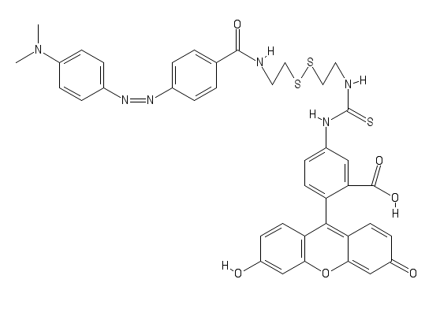
DSSQ1
MW= 792
E_{x}max: 485-495
E_{m}max: 516-525

Slide 3
Co-localization of NIH/3T3 with DSSQ1 (20µM) and TMRM (200nM)
Methods
NIH/3T3 cells were plated on MatTek Dish at 6000cells/mL and incubated w/ CO₂ for 24hours in complete media
Dish media was washed out and replaced with HBSS plus Hoechst(1µg/ml), TMRM(200nM), and DSSQ1(20µM) then incubated w/ CO₂ for 30min
Dish was washed and imaged using Olympus Confocal and analyzed with Olympus Fluroview

Slide 4
Co-localization of NIH/3T3 with DSSQ1 (20µM) and TMRM (200µM)
Hoechst
DSSQ1 (20µM)
TMRM
Combined

Slide 5
Co-localization of NIH/3T3 with DSSQ1 (20µM) and LysoTracker Red (1µM)
Methods
NIH/3T3 cells were plated on MatTek Dish at 6000cells/mL and incubated w/ CO₂ for 48hours in complete media
All dish media was washed out and replaced with HBSS+HEPES (25mM) and incubated for 30min
Dishes were washed and incubated for 30min with the solutions indicated below
Dishes were washed and imaged using Nikon Confocal and analyzed with Nikon NIS Elements
Control | LysoTracker Red
HBSS+HEPES(25mM) | HBSS+HEPES(25mM)
Hoechst(1µg/ml) | Hoechst(1µg/ml)
DSSQ1(20µM) | DSSQ1(20µM)
TMRM (200nM) | LysoTracker Red (1µM)

Slide 6
Co-localization of NIH/3T3 with DSSQ1 (20µM) and LysoTracker Red (1µM)
Control
Lyso-Tracker Red
Hoechst
DSSQ1
Hoechst
DSSQ1
40uM
40uM
40uM
40uM
TMRM
Combined
LysoRed
Combined
40uM
40uM
40uM
40uM

Slide 7
Effects of 30 min Co-incubation of NIH/3T3 cells with H₂0₂ (100 µM) and DSSQ1 (20 µM)
Methods
NIH/3T3 cells were plated on MatTek Dish at 6000cells/mL and incubated w/ CO₂ for 24hours in complete media
Dish media was washed out and replaced with the following solutions and incubated for 30min covered in parafilm
Dish was washed and imaged using Olympus Confocal and analyzed with Olympus Fluroview
Control | H₂0₂
HBSS | HBSS
Hoechst(1µg/ml) | Hoechst(1µg/ml)
DSSQ1(20µM) | DSSQ1(20µM)
TMRM (200nM) | TMRM (200nM)
 | H₂0₂ (100 µM)

Slide 8
Effects of 30 min Co-incubation of NIH/3T3 cells with
H₂0₂ (100 µM) and DSSQ1 (20 µM)
Control
H₂0₂ 100 µM
Hoechst
DSSQ1
Hoechst
DSSQ1
TMRM
Combined
TMRM
Combined

Slide 9
Effects of 30 min Co-incubation of NIH/3T3 cells with
N-Acetyl Cysteine (10 mM) and DSSQ1 (20 µM)
Methods
NIH/3T3 cells were plated on MatTek Dish at 6000cells/mL and incubated w/ CO₂ for 24hours in complete media
Dish media was washed out and replaced with the following solutions and incubated for 30min covered in parafilm
Dish was washed and imaged using Olympus Confocal and analyzed with Olympus Fluroview
Control | N-Acetyl Cysteine
HBSS | HBSS
Hoechst(1µg/ml) | Hoechst(1µg/ml)
DSSQ1(20µM) | DSSQ1(20µM)
TMRM (200nM) | TMRM (200nM)
 | N-Acetyl Cysteine (10mM)

Slide 10
Effects of 30 min Co-incubation of NIH/3T3 cells with
N-Acetyl Cysteine (10 mM) and DSSQ1 (20 µM)
Control
NAC 10 mM
Hoechst
DSSQ1
Hoechst
DSSQ1
TMRM
Combined
TMRM
Combined

Slide 11
Effects of 30 min Co-incubation of NIH/3T3 cells with
H₂O₂ (100 µM), N-Acetyl Cysteine (10 mM) and DSSQ1 (20µM)
Methods
NIH/3T3 cells were plated on MatTek Dish at 6000cells/mL and incubated w/ CO₂ for 24hours in complete media
Dish media was washed out and replaced with the following solutions and incubated for 30min covered in parafilm
Dish was washed and imaged using Olympus Confocal and analyzed with Olympus Fluroview
Control | N-Acetyl Cysteine
HBSS | HBSS
Hoechst(1µg/ml) | Hoechst(1µg/ml)
DSSQ1(20µM) | DSSQ1(20µM)
TMRM (200nM) | TMRM (200nM)
 | N-Acetyl Cysteine (10mM)
 | H₂0₂ (100 µM)

Slide 12
Effects of 30 min Co-incubation of NIH/3T3 cells with
H₂O₂ (100 µM), N-Acetyl Cysteine (10 mM) and DSSQ1 (20 µM)
Control
H₂0₂ 100uM + NAC 10uM
Hoechst
DSSQ1
Hoechst
DSSQ1
TMRM
Combined
TMRM
Combined

Slide 13
Effects of 30min Pre-incubation of NIH/3T3 with H₂0₂(100mM) on DSSQ1 (20µM)
Methods
NIH/3T3 cells were plated on MatTek Dish at 6000cells/mL and incubated w/ CO₂ for 48hours in complete media
Dish media was washed out and replaced with the following solutions and incubated for 30min
Dish media was washed out and incubated for 30min with HBSS plus HEPES(25mM), Hoechst (1µg/mL), DSSQ1 (20µM), and TMRM (200nM) for 30min
Dishes were imaged using Nikon Confocal and analyzed with Nikon NIS Elements
Control | H₂0₂
HBSS+HEPES(25mM) | HBSS+HEPES(25mM)
Hoechst(1µg/ml) | Hoechst(1µg/ml)
DSSQ1(20µM) | DSSQ1(20µM)
TMRM (200nM) | TMRM (200nM)
 | H₂0₂ (100mM)

Slide 14
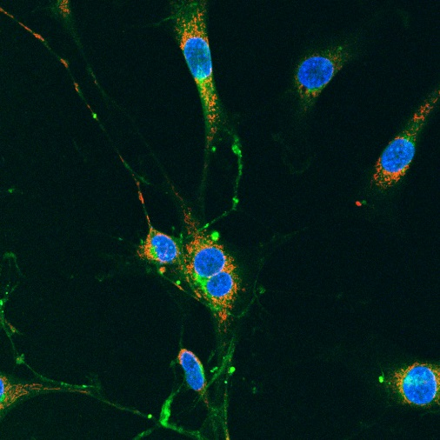
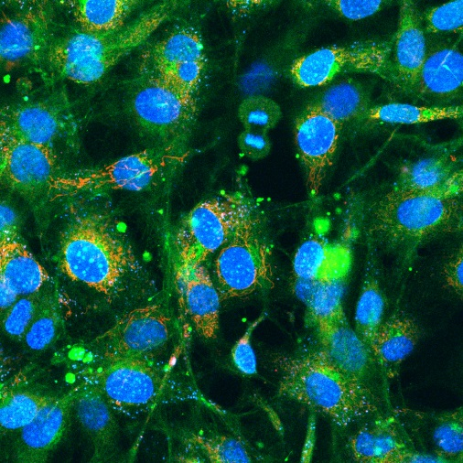
Effects of 30 min Pre-incubation of NIH/3T3 cells with H₂0₂(100 µM) on DSSQ1(20µM)
Control
H₂0₂ 100 µM
Hoechst
DSSQ1
Hoechst
DSSQ1
40uM
40uM
40uM
40uM
TMRM
Combined
TMRM
Combined
40uM
40uM
40uM
40uM

Slide 15
Effects of 30 min Pre-incubation of NIH/3T3 cells with N-Acetyl Cysteine (1mM) on DSSQ1(20µM)
Methods
NIH/3T3 cells were plated on MatTek Dish at 6000cells/mL and incubated w/ CO₂ for 48hours in complete media
Dish media was washed out and replaced with the following solutions and incubated for 30min
Dish media was washed out and incubated for 30min with HBSS+HEPES(25mM), Hoechst (1µg/mL), DSSQ1 (20µM), and TMRM (200nM) for 30min
Dishes were washed with HBSS+HEPES and imaged using Nikon Confocal and analyzed with Nikon NIS Elements
Control | H₂0₂
HBSS+HEPES(25mM) | HBSS+HEPES(25mM)
Hoechst(1µg/ml) | Hoechst(1µg/ml)
DSSQ1(20µM) | DSSQ1(20µM)
TMRM (200nM) | TMRM (200nM)
 | NAC (1mM)

Slide 16
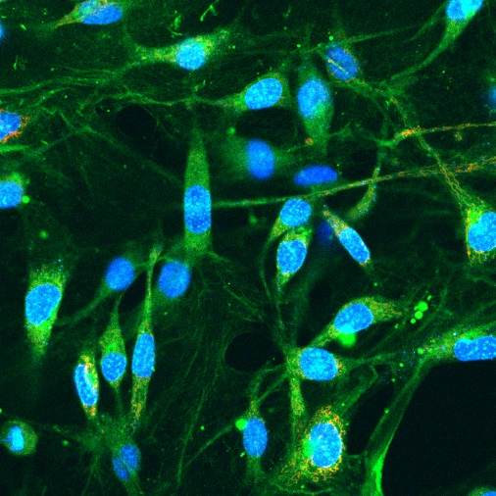
Effects of 30 min Pre-incubation of NIH/3T3 cells with
N-Acetyl Cysteine (1 mM) and DSSQ1 (20 µM)
Control
NAC 1 mM
Hoechst
DSSQ1
Hoechst
DSSQ1
40uM
40uM
40uM
40uM
TMRM
Combined
TMRM
Combined
40uM
40uM
40uM
40uM

Slide 17
Effects of 30 min Pre-incubation of NIH/3T3 cells with N-Acetyl Cysteine (10 mM) on DSSQ1(20µM)
Methods
NIH/3T3 cells were plated on MatTek Dish at 6000cells/mL and incubated w/ CO₂ for 48hours in complete media
Dish media was washed out and replaced with the following solutions and incubated for 30min
Dish media was washed out and incubated for 30min with HBSS+HEPES(25mM), Hoechst (1µg/mL), DSSQ1 (20µM), and TMRM (200nM) for 30min
Dishes were washed out with HBSS+HEPES and imaged using Nikon Confocal and analyzed with Nikon NIS Elements
Control | N-Acetyl Cysteine
HBSS+HEPES(25mM) | HBSS+HEPES(25mM)
Hoechst(1µg/ml) | Hoechst(1µg/ml)
DSSQ1(20µM) | DSSQ1(20µM)
TMRM (200nM) | TMRM (200nM)
 | NAC (10mM)

Slide 18
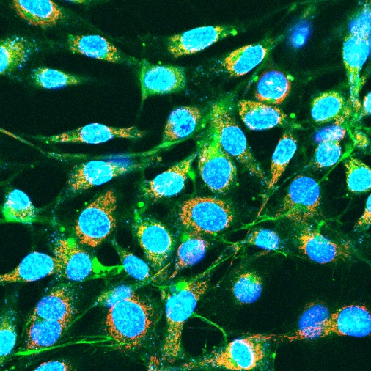
Effects of 30 min Pre-incubation of NIH/3T3 cells with N-Acetyl Cysteine (10mM) on DSSQ1(20µM)
Control
NAC 10 mM
Hoechst
DSSQ1
Hoechst
DSSQ1
40uM
40uM
40uM
40uM
TMRM
Combined
TMRM
Combined
40uM
40uM
40uM
40uM

